Slide 1

SDD - Timetable Management System for FSKSM
AD2122J-Alpha
MOHD RAZAK BIN SAMINGAN
Ruhul Quddus Tamim Md Yusuf Bin Forkan Syafiq Ibnu Ramadhan Shafi Ahmed

Slide 2
Application Structure
FSKSM application was developed by using component-based and database-oriented Web framework with its main link structure information is dynamically stored inside application database tables. Part of the logic of FSKSM application is to extract this link structure information from the database and present them as a normal hypertext links of a web application. The users access the services provided by the FSKSM application by clicking these hypertext links. Each node that used to build FSKSM application link structure is attached with specific modules configured to provide application function to the users. Not only the link nodes, application modules which are attached to them also have their parameter settings and access privileges control were dynamically stored inside the database. This section provides basic information about main link structure of FSKSM application, sub child nodes connected to the link structure and modules attached to each of this sub child node. Details information about modules attached to each of this link nodes, parameter settings and access control applied to them are accessible from the Web-based and mobile based application development and administration tools incorporated inside the Web and Mobile framework used to develop the FSKSM system.

Slide 3
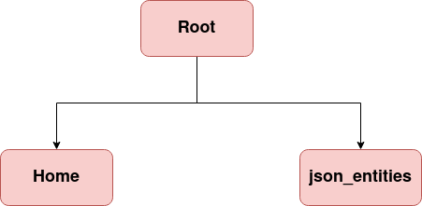
Main Link Structure
The main link structure of FSKSM application. The "Root" node is a virtual one that will not be visible as application page. Main control pages of application which need to be opened by using standard browser inside the desktop or mobile environment are all ported inside the "Home" node. The "json_entities" node was used to provide JSON data service for both the mobile and web(FSKSM) and the backend applications of FSKSM system. The next sections describe in detail the sub structure and modules attached to the “Home” and "json_entities" link nodes.

Slide 4
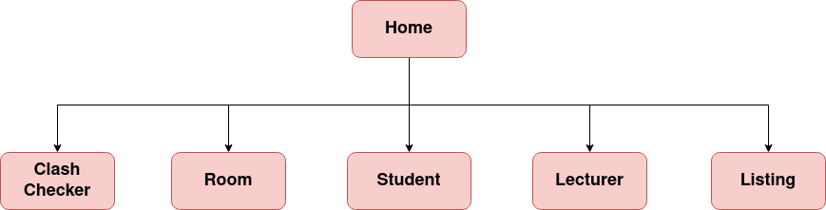
Home Link Structure(Conceptual)
"Home" link node is accessible to all types of group but access to its real/physical child nodes can be categorized and controlled by the "Admin". In this documentation, these conceptual child nodes are used to describe application logic and page view control imposed by the system.

Slide 5
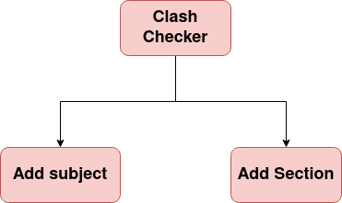
"Clash Checker" Sub-Link Structure
The “Add subject” and “Add section” sub link nodes can be accessed by any users even from outside too.

Slide 6
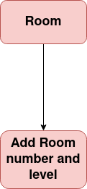
"Room" Sub-Link Structure
The “Add Room number and level” sub link nodes can be accessed by any UTM staffs, students, lecturers and outsiders and they input the room number and level to display.

Slide 7
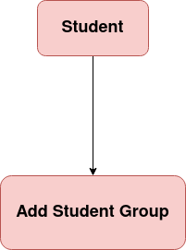
"Student" Sub-Link Structure
The “Add Student Group” sub link nodes can be accessed by any UTM staffs, students, lecturers and outsiders and inputting the Student Group to generate the automated timetable.

Slide 8
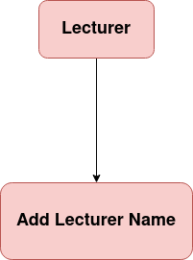
"Lecturer" Sub-link Structure
The “Add Lecturer” sub link nodes can be accessed by any UTM staffs, students, lecturers and outsiders and inputting the Lecturer Name will generate the automated timetable for lecturer.

Slide 9
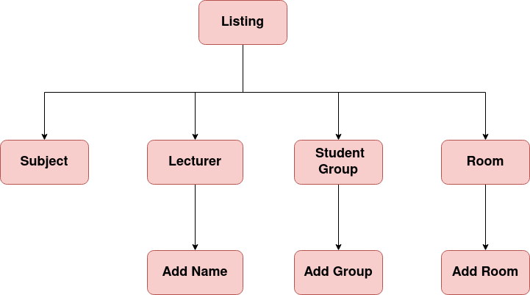
"Listing" Sub-Link Structure

Slide 10
DATABASE DESIGN
The conceptual design of FSKSM application derived from the initial proposal of the system. There are seven (7) core sub-sections of main data components that can be extracted from this conceptual design. They are as follows:
Student
Lecturer
Course
Semester
Subject
Timetable
FSKSM

Slide 11
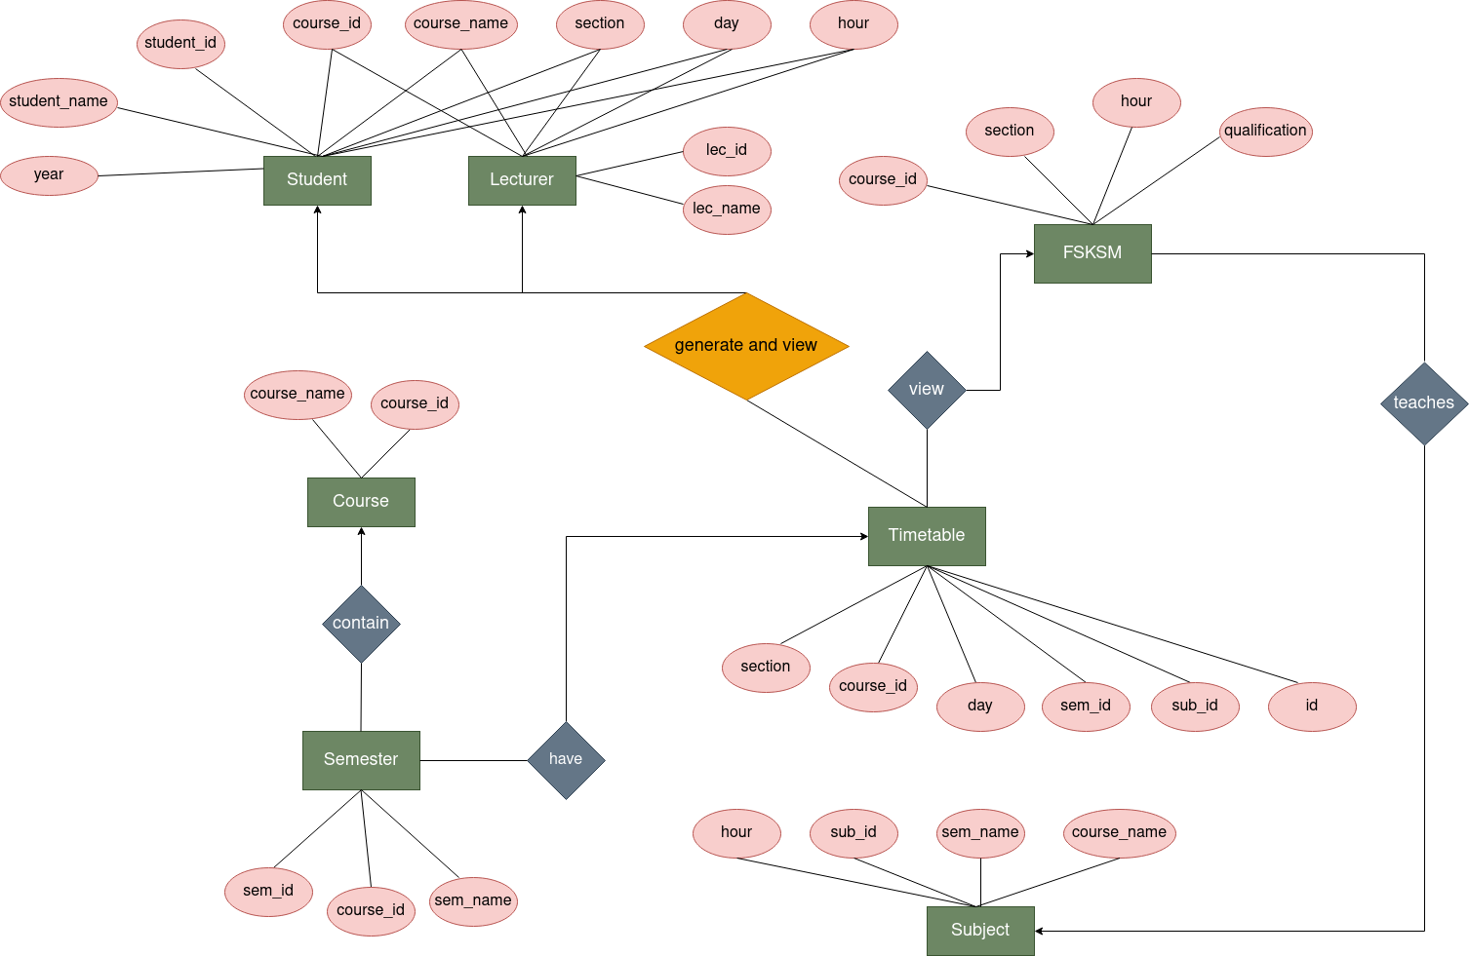
Database conceptual design

Slide 12
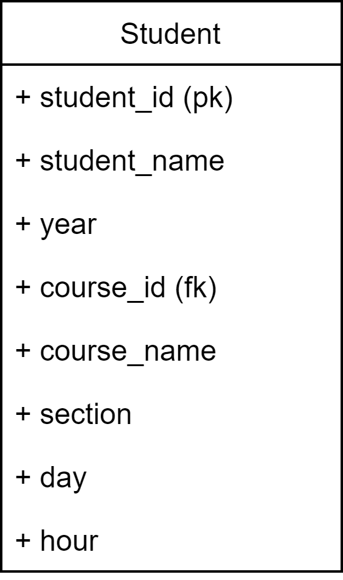
Student
Table Name: Student
Table Description:
Stores main information about student name, year and the generator generates a timetable for student's section.

Slide 13
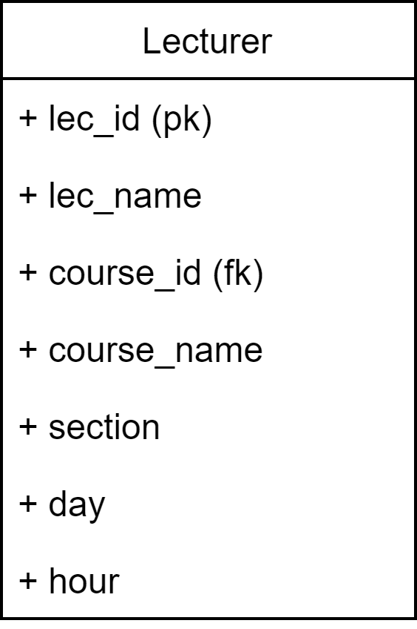
Lecturer
Table Name: Lecturer
Table Description:
Stores main information about lecturer name and generates a timetable for each lecturer

Slide 14
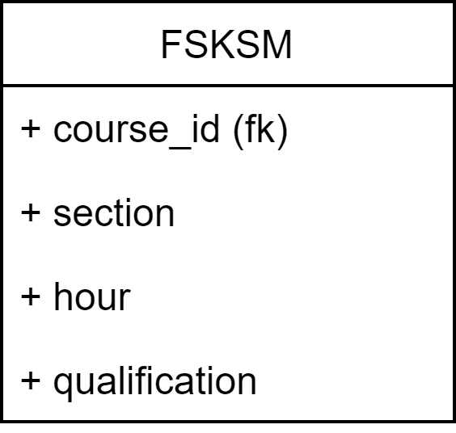
FSKSM
Table Name: FSKSM
Table Description:
Stores information about the course and its corresponding section, hour and the type of qualification.

Slide 15
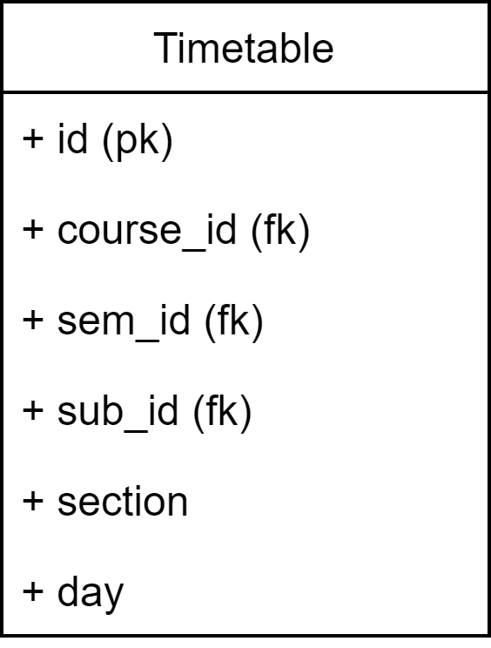
Timetable
Table Name: Timetable
Table Description:
Take the current information about the semester and view the FSKSM website to take the information about the course and section, thus generate a timetable for all the sections.

Slide 16
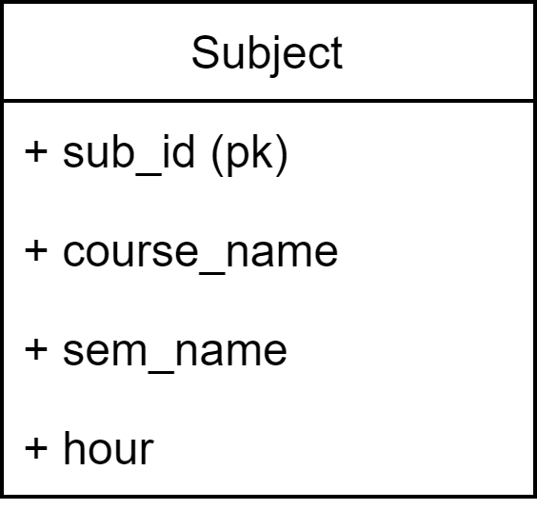
Subject
Table Name: Subject
Table Description:
Stores information about the course name, duration/hour of class, and in which semester it is being taught.

Slide 17
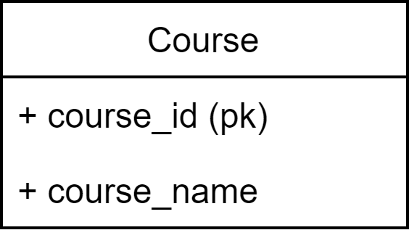
Course
Table Name: Course
Table Description:
Stores information about course name

Slide 18
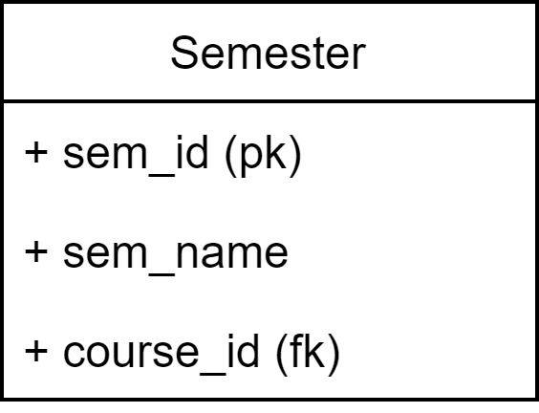
Semester
Table Name: Semester
Table Description:
Stores the current information about course and semester and pass its information it to the Timetable.

